Slide 1
Nano-CT breakdown into 2µm qPRS cubes + intensity values export

Slide 2
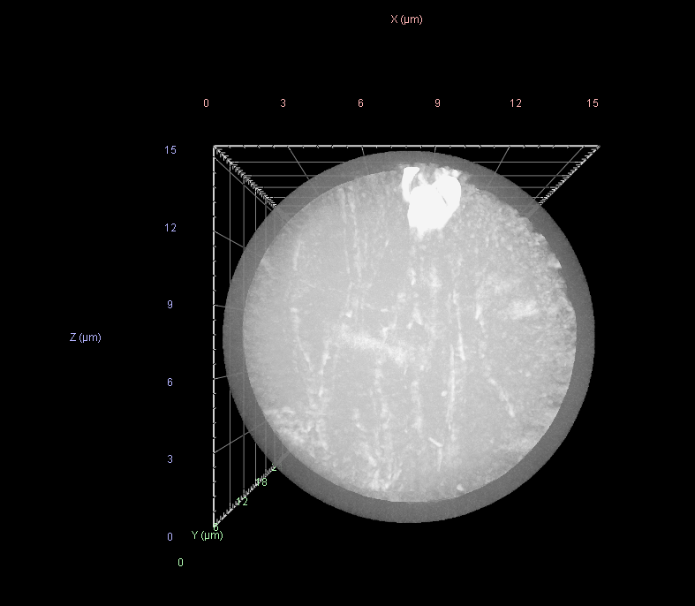
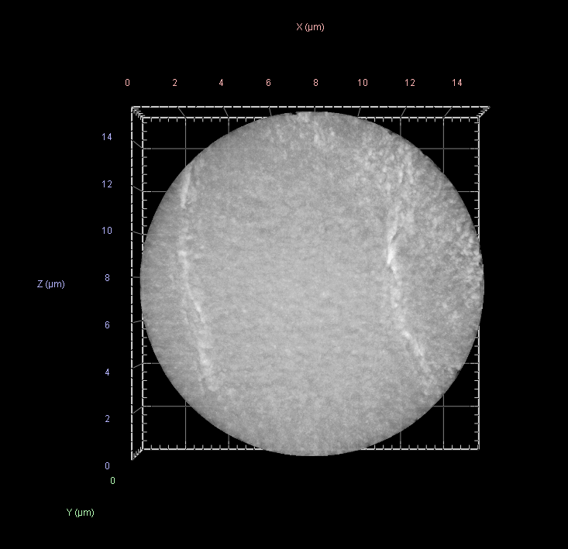
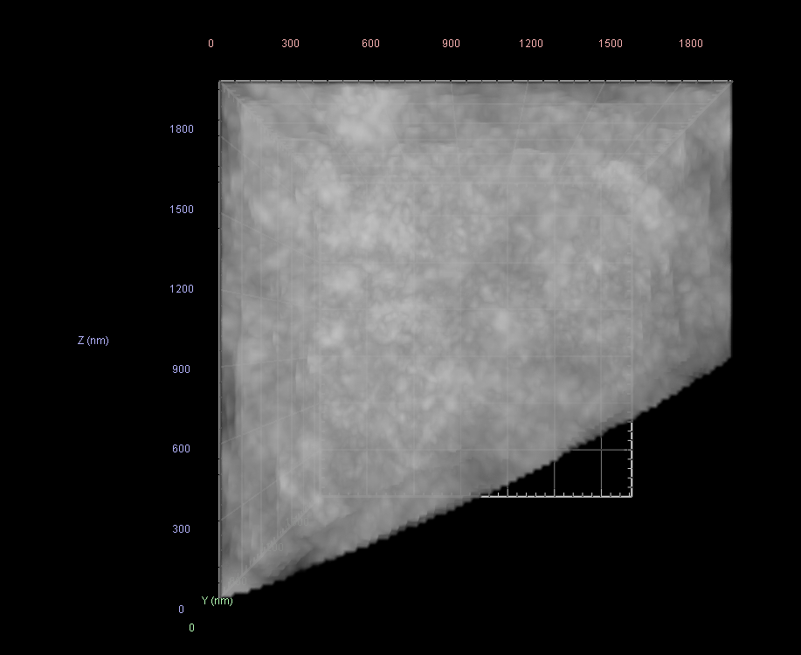
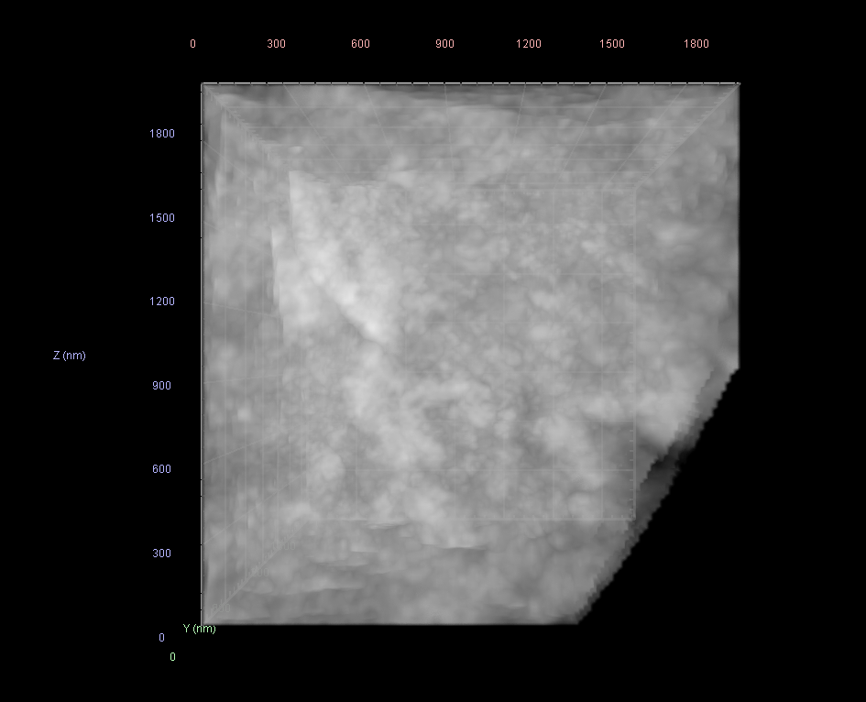
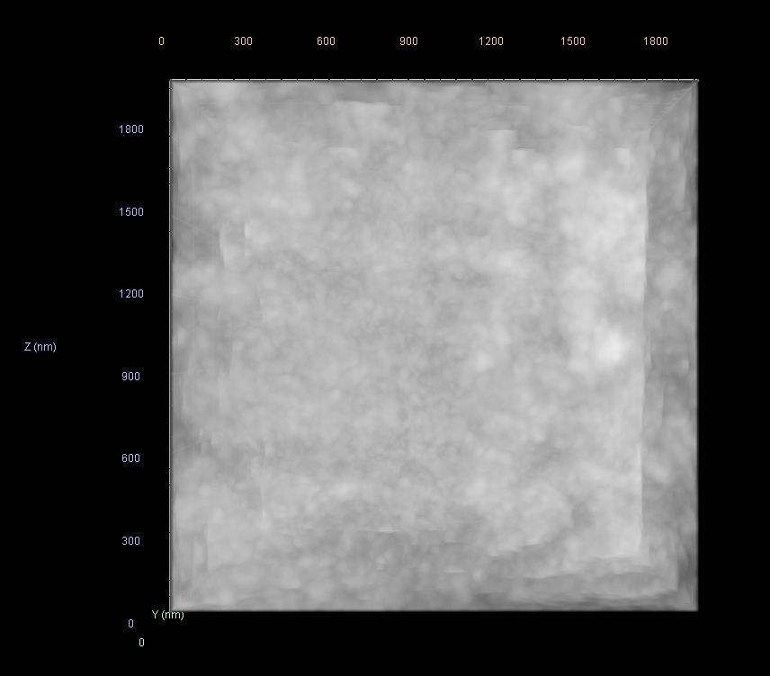
20
15
10
2
9
1
13
4
Approximate! positions
3
5 um deep layer
Point4
Point3
Point9

Slide 3
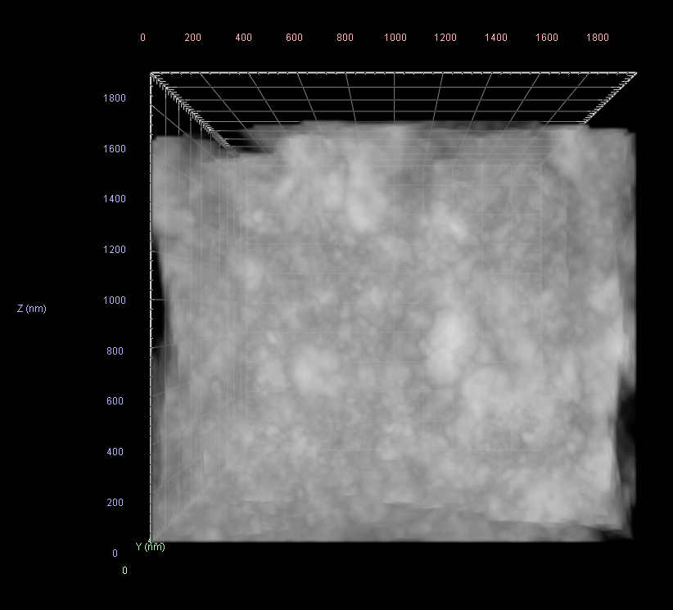
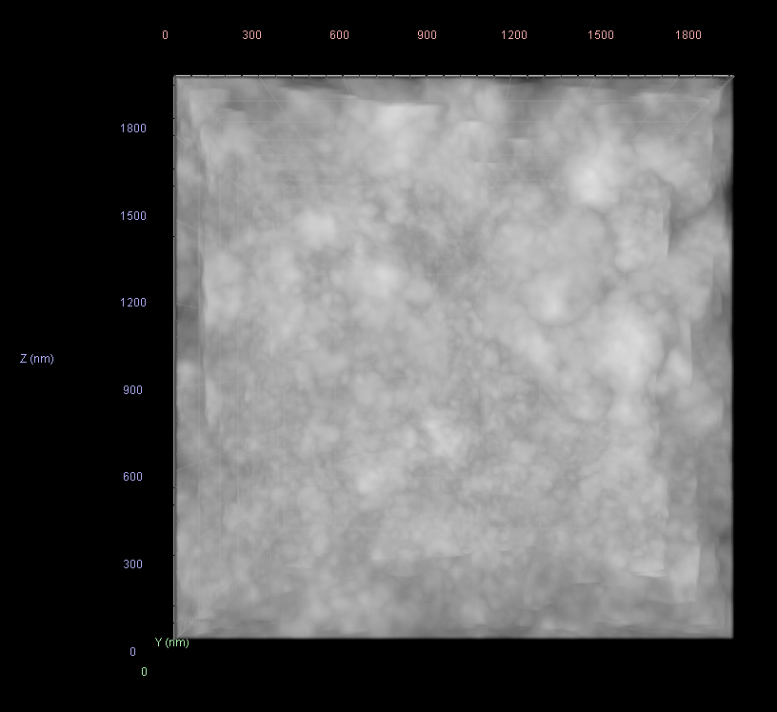
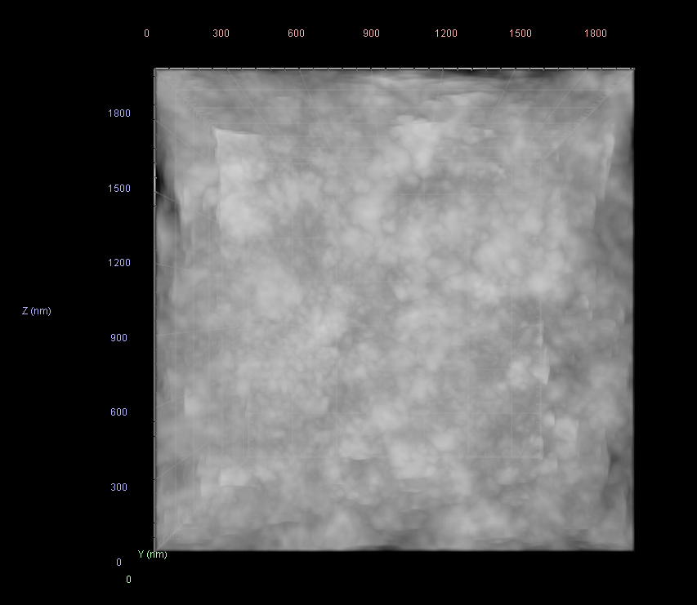
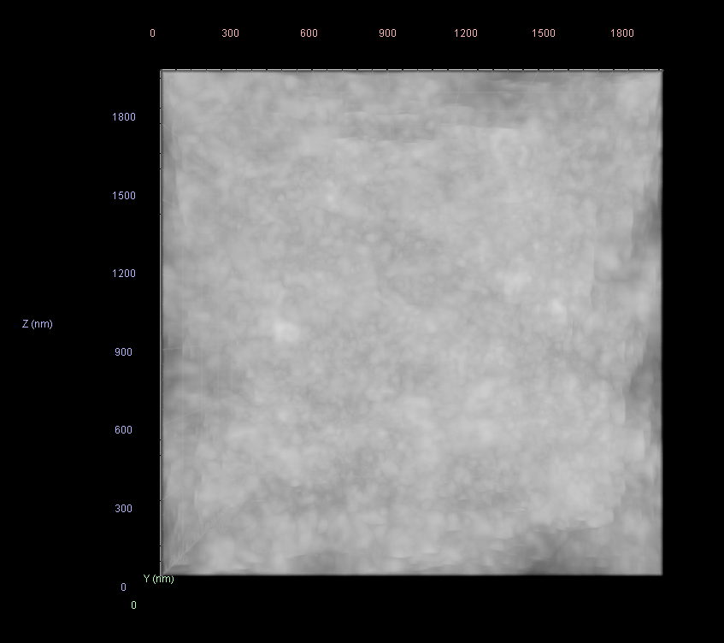
Point20
Point15
Point9
Point10
Point4
Point3
Point13
I did not do the pore segmentation for this one

Slide 4
Point | xARp | zARp | yARp1 | xARpStart | xARpEnd | zARpStart | zARpEnd | yARpStart | yARpEnd | Volume, Volume (µm³) | Min, Intensities #1 | Max, Intensities #1 | Mean, Intensities #1 | Sum, Intensities #1 | SD, Intensities #1 | SNR (Mean/SD), Intensities #1
Point3 | 1194.376329 | 93.22061019 | 700.5 | 1132.376329 | 1256.376329 | 31.22061019 | 155.2206102 | 638.5 | 762.5 | 6.414580592 | 791 | 58369 | 49202.05 | 7.58E+10 | 2784.169 | 17.67208
Point4 | 1349.698595 | 265.1191674 | 700.5 | 1287.698595 | 1411.698595 | 203.1191674 | 327.1191674 | 638.5 | 762.5 | 7.471507822 | 25696 | 63482 | 49284.69 | 8.84E+10 | 2914.487 | 16.91024
Point9 | 1177.801086 | 420.4404854 | 700.5 | 1115.801086 | 1239.801086 | 358.4404854 | 482.4404854 | 638.5 | 762.5 | 8.006109315 | 21417 | 64359 | 51607 | 9.92E+10 | 2869.828 | 17.98261
Point10 | 1333.123352 | 592.3390426 | 700.5 | 1271.123352 | 1395.123352 | 530.3390426 | 654.3390426 | 638.5 | 762.5 | 8.006109315 | 28845 | 59873 | 49437.45 | 9.5E+10 | 2856.438 | 17.30738
Point13 | 850.5813121 | 403.8632461 | 700.5 | 788.5813121 | 912.5813121 | 341.8632461 | 465.8632461 | 638.5 | 762.5 | 8.006109315 | 43190 | 61116 | 52255.16 | 1E+11 | 1766.525 | 29.58076
Point15 | 1161.225843 | 747.6603605 | 700.5 | 1099.225843 | 1223.225843 | 685.6603605 | 809.6603605 | 638.5 | 762.5 | 8.006109315 | 28985 | 62087 | 49926.95 | 9.6E+10 | 3106.889 | 16.06976
Point20 | 989.3283344 | 902.9816785 | 700.5 | 927.3283344 | 1051.328334 | 840.9816785 | 964.9816785 | 638.5 | 762.5 | 6.852192362 | 978 | 60879 | 48607.21 | 8E+10 | 3046.925 | 15.95288

Slide 5
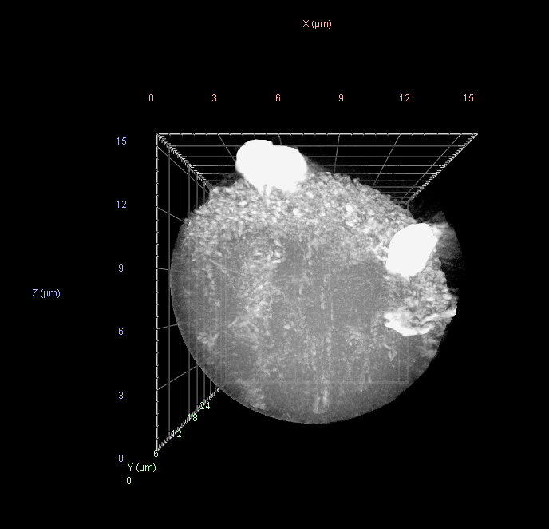
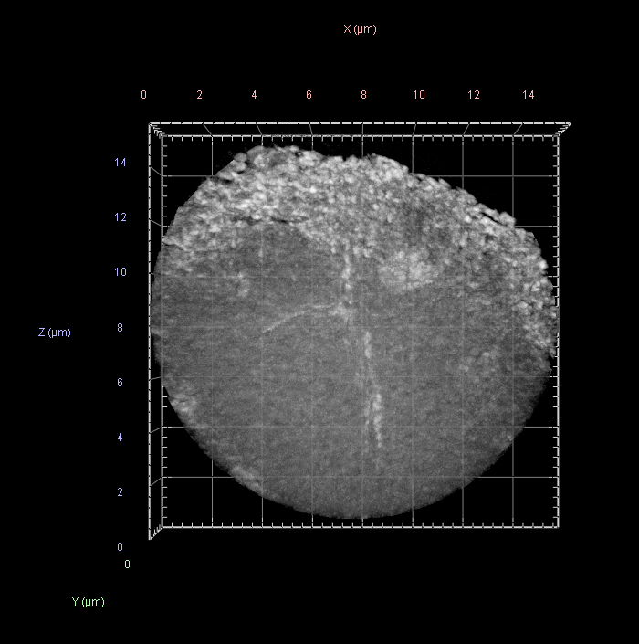
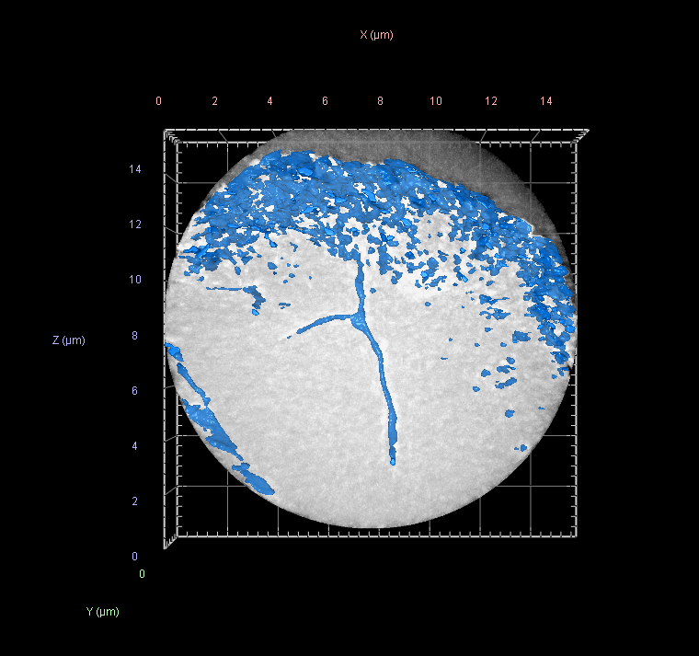
3
2
Warning: Indigo1 Intensity values are not intrinsic to nanoCT measurement due to the RBG conversion used for stitching
Indigo 1

Slide 6
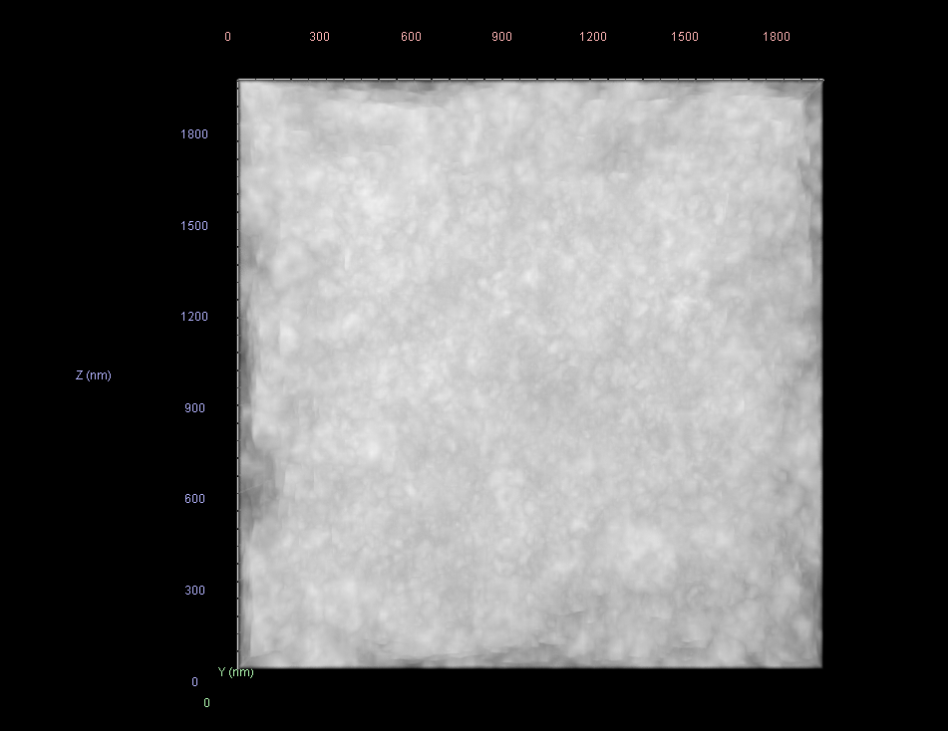
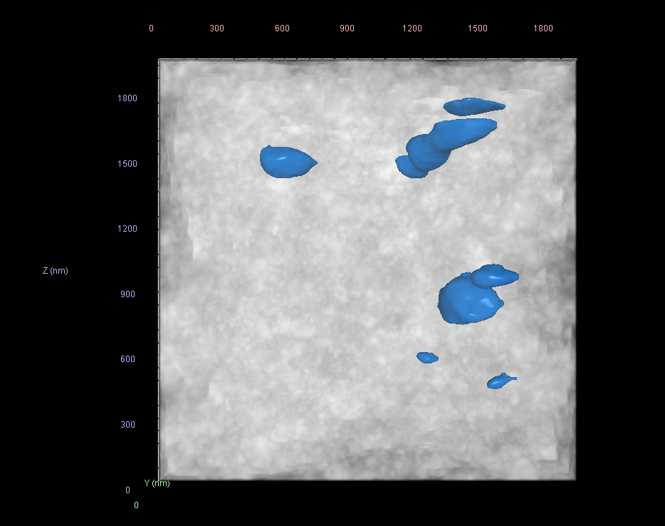
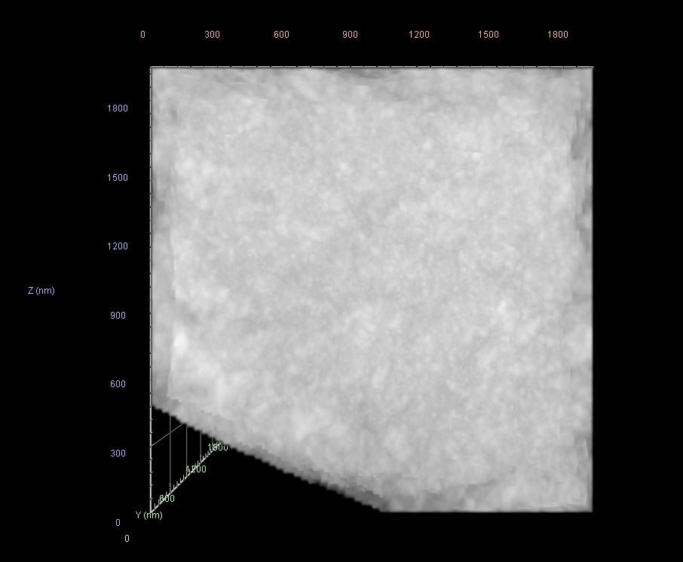
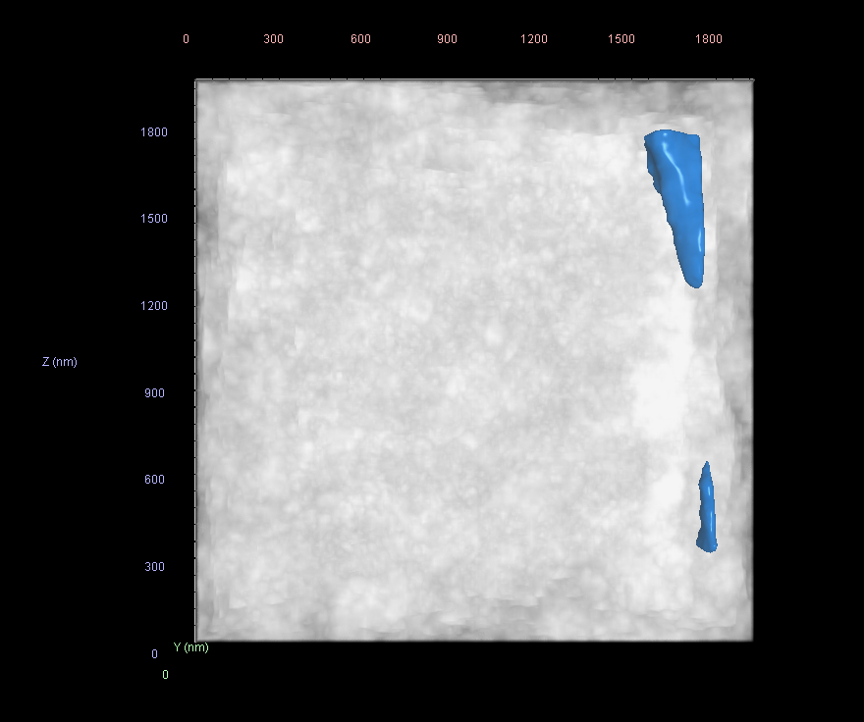
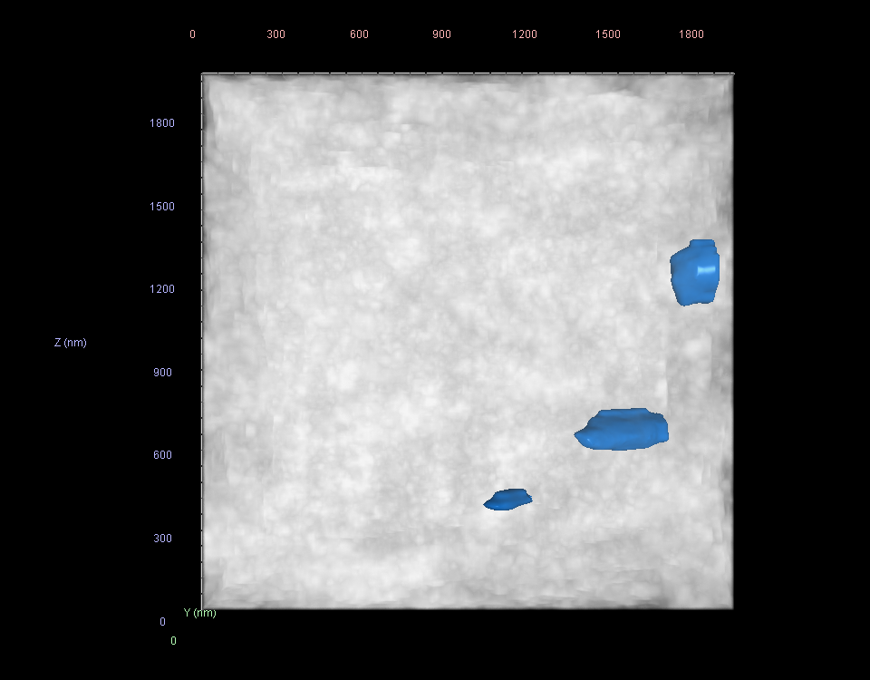
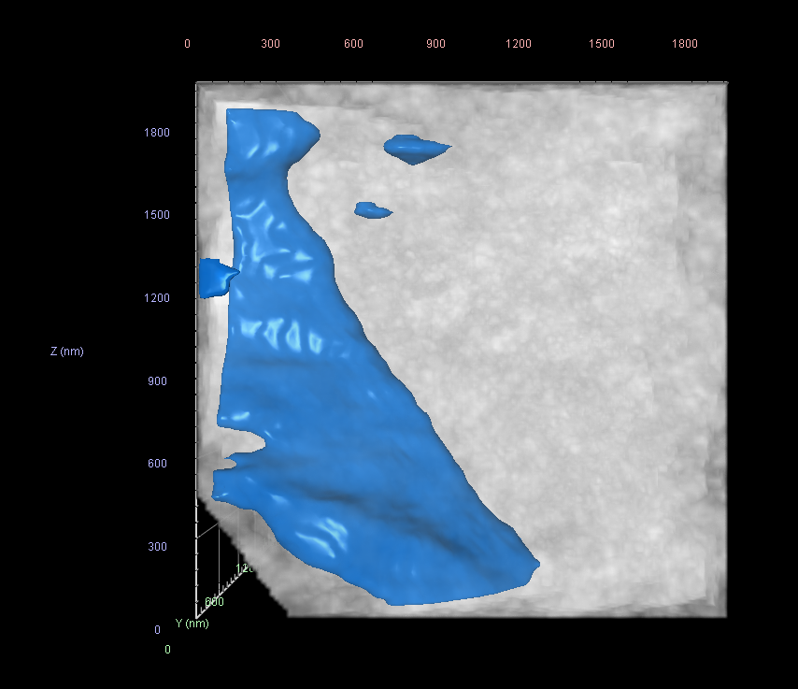
Point10
Point13
Point9
Point14
Point15
Point18

Slide 7
Point | xARp | zARp | yARp1 | xARpStart | xARpEnd | zARpStart | zARpEnd | yARpStart | yARpEnd | Volume, Volume (µm³) | Center X, 3D Oriented Bounds (µm) | Center Y, 3D Oriented Bounds (µm) | Center Z, 3D Oriented Bounds (µm) | Min, Intensities #1 | Max, Intensities #1 | Mean, Intensities #1 | Sum, Intensities #1 | SD, Intensities #1 | SNR (Mean/SD), Intensities #1 | VoxelCount, Volume
Point9 | 1588.935956 | 155.7663219 | 766 | 1526.935956 | 1650.935956 | 93.76632195 | 217.7663219 | 704 | 828 | 8.006109 | 25.55896 | 12.31689 | 0.99758 | 38095 | 55375 | 47090.66 | 9.05E+10 | 1784.636 | 26.3867 | 1922000
Point10 | 1736.861923 | 319.4792336 | 766 | 1674.861923 | 1798.861923 | 257.4792336 | 381.4792336 | 704 | 828 | 8.006109 | 27.94028 | 12.31689 | 0.99758 | 23322 | 56041 | 46644.55 | 8.97E+10 | 2272.82 | 20.52276 | 1922000
Point13 | 1277.298076 | 139.978475 | 766 | 1215.298076 | 1339.298076 | 77.97847503 | 201.978475 | 704 | 828 | 7.530391 | 20.65773 | 12.3169 | 1.135217 | 33791 | 56149 | 46949.04 | 8.49E+10 | 1756.997 | 26.72118 | 1807796
Point14 | 1425.224043 | 303.6913867 | 766 | 1363.224043 | 1487.224043 | 241.6913867 | 365.6913867 | 704 | 828 | 8.006109 | 22.9202 | 12.31689 | 0.99758 | 21510 | 58977 | 48331.97 | 9.29E+10 | 2002.086 | 24.1408 | 1922000
Point15 | 1573.15001 | 467.4042983 | 766 | 1511.15001 | 1635.15001 | 405.4042983 | 529.4042983 | 704 | 828 | 8.006109 | 25.30153 | 12.31689 | 0.99758 | 31439 | 57247 | 47998.48 | 9.23E+10 | 2060.728 | 23.292 | 1922000
Point18 | 1113.586163 | 287.9035397 | 766 | 1051.586163 | 1175.586163 | 225.9035397 | 349.9035397 | 704 | 828 | 7.846504 | 18.01788 | 12.31689 | 1.080286 | 25372 | 57537 | 46563.36 | 8.77E+10 | 2504.296 | 18.59339 | 1883684

Slide 8
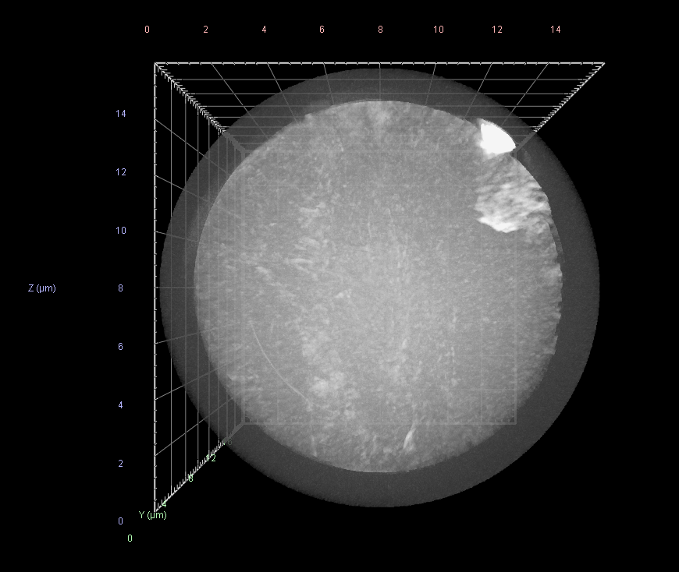
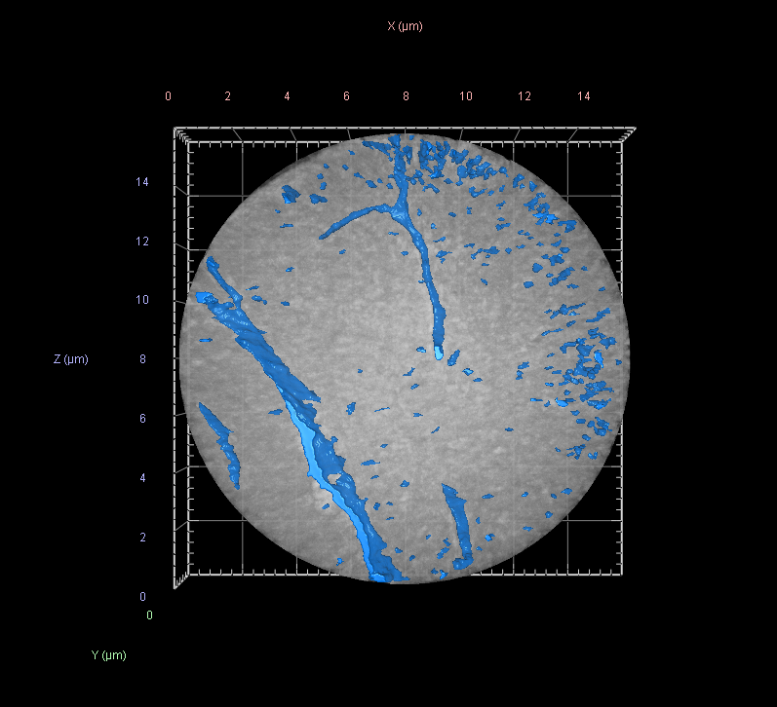
Indigo 2

Slide 9
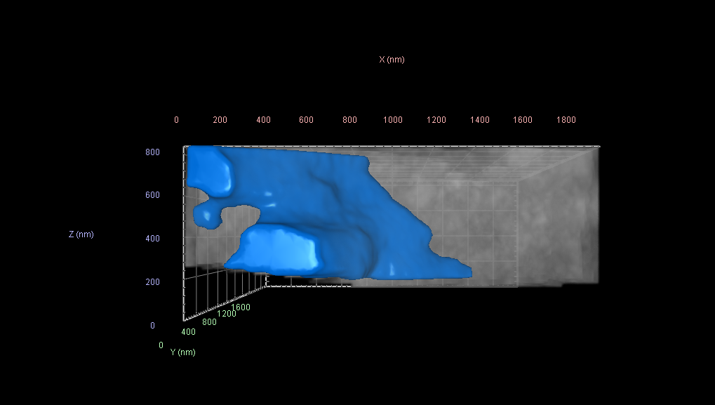
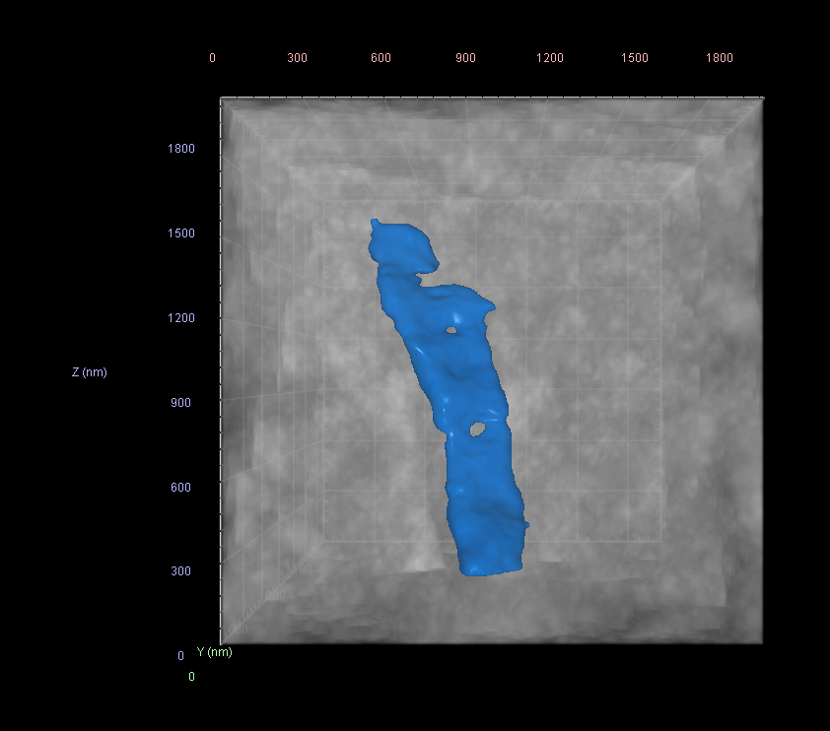
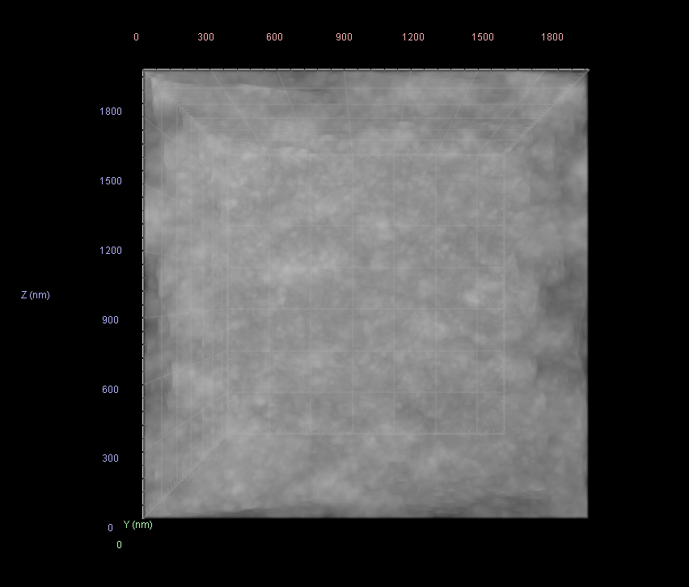
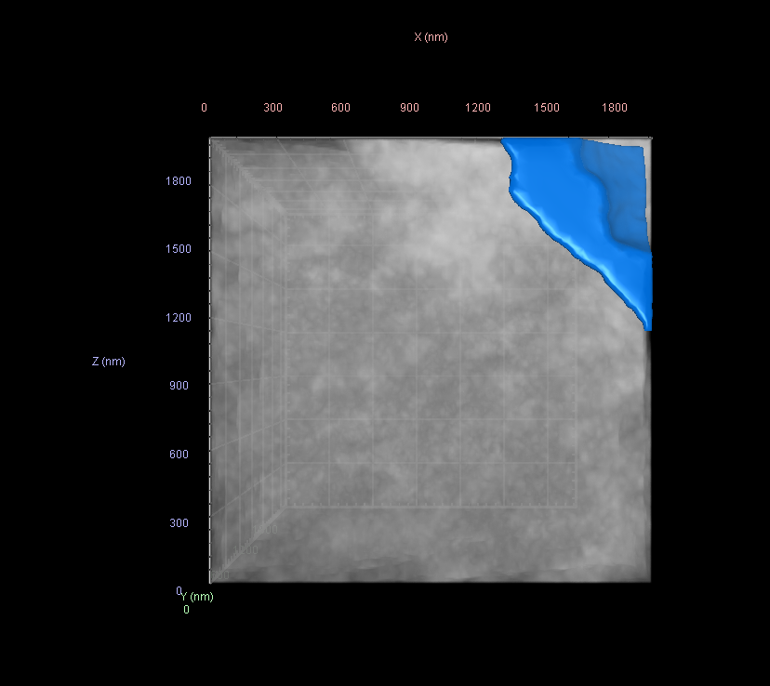
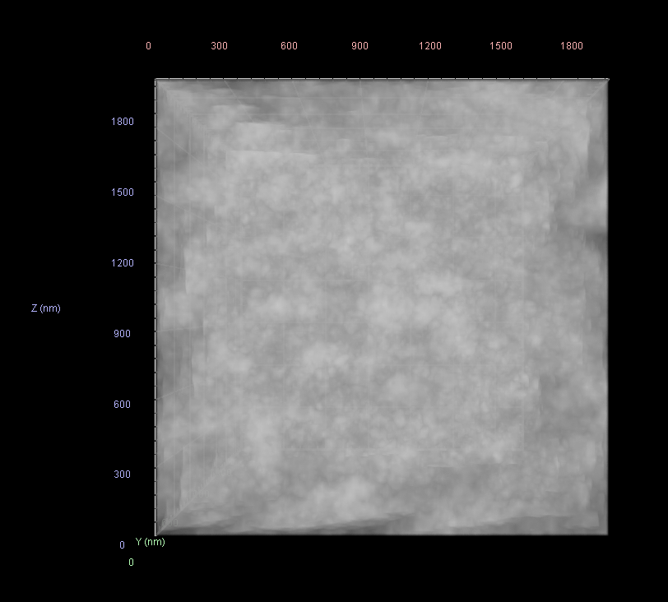
Point2
Point3
Point4
Point7
Point8

Slide 10
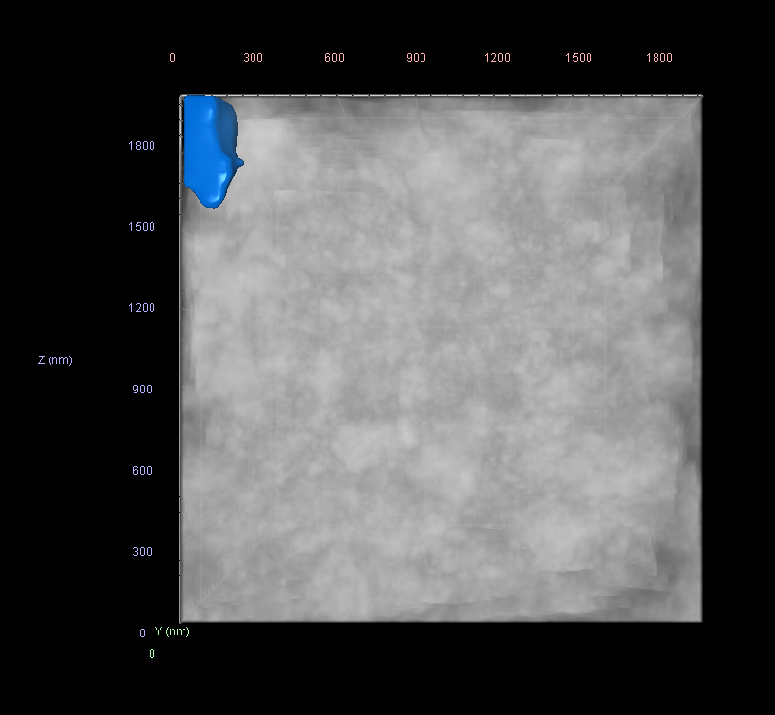
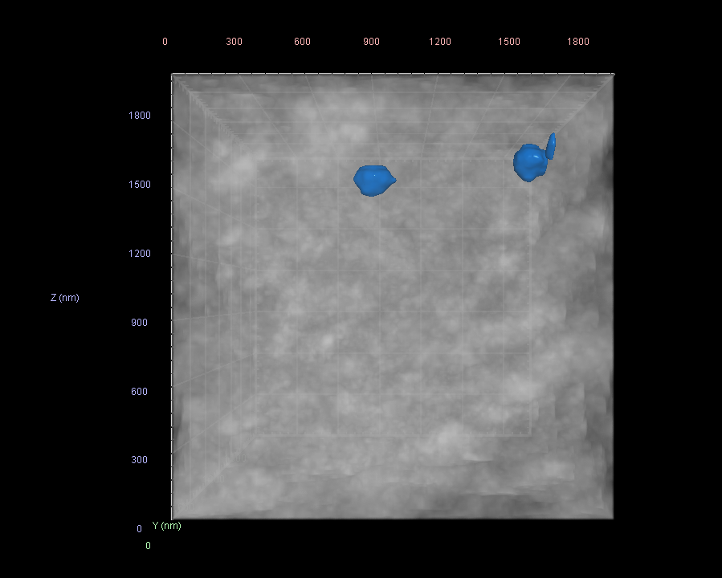
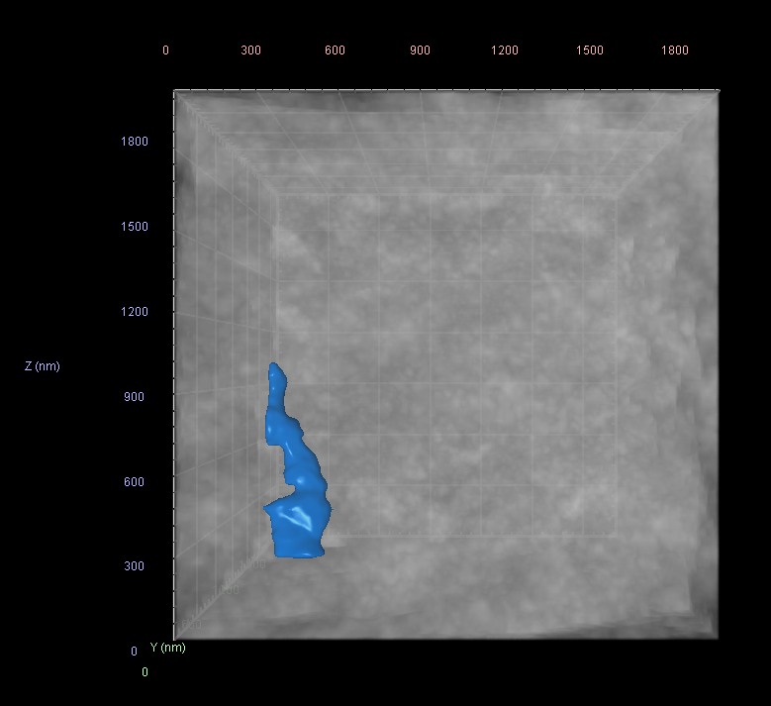
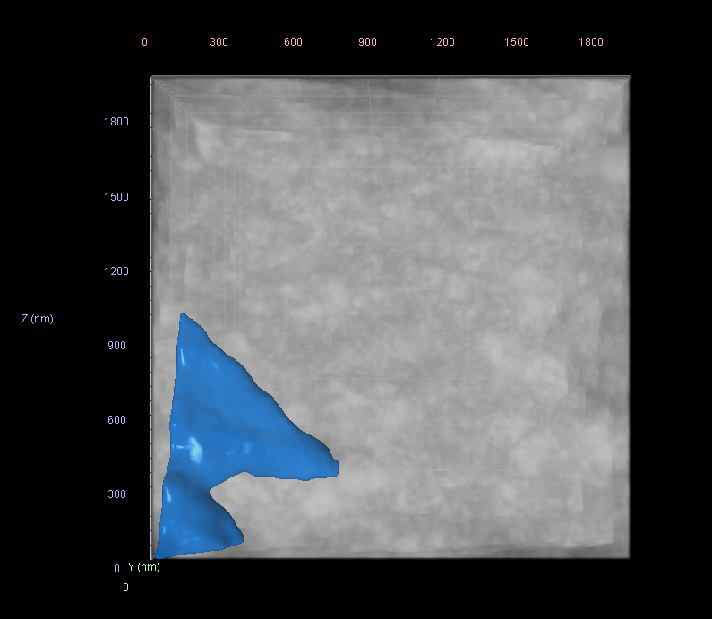
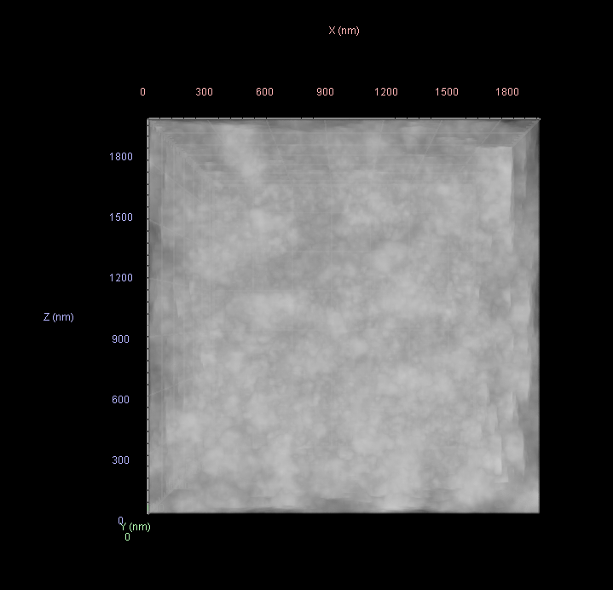
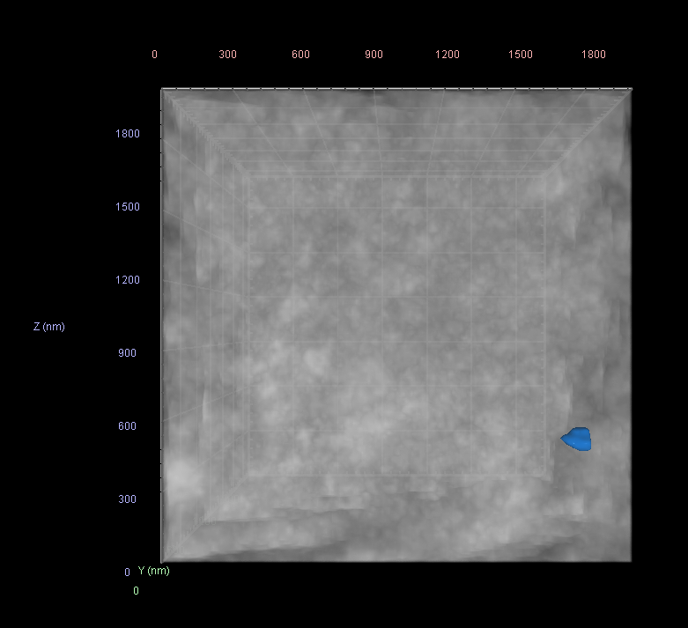
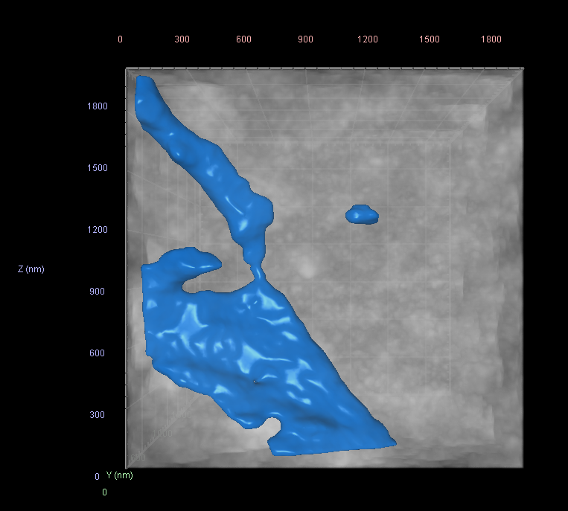
Point9
Point10
Point12
Point13
Point14
Point15
Point18

Slide 11
Point | xARp | zARp | yARp1 | xARpStart | xARpEnd | zARpStart | zARpEnd | yARpStart | yARpEnd | Volume, Volume (µm³) | Center X, 3D Oriented Bounds (µm) | Center Y, 3D Oriented Bounds (µm) | Center Z, 3D Oriented Bounds (µm) | Min, Intensities #1 | Max, Intensities #1 | Mean, Intensities #1 | Sum, Intensities #1 | SD, Intensities #1 | SNR (Mean/SD), Intensities #1 | VoxelCount, Volume
Point2 | 476.6261962 | -9.580247985 | 582.5 | 414.6261962 | 538.6261962 | -71.58024799 | 52.41975201 | 520.5 | 644.5 | 2.606368 | 7.666894 | 9.356336 | 0.499246 | 39120 | 47320 | 44439.78 | 2.78E+10 | 714.5542 | 62.19231 | 625702
Point3 | 630.7277095 | 148.3334398 | 582.5 | 568.7277095 | 692.7277095 | 86.33343976 | 210.3334398 | 520.5 | 644.5 | 8.006109 | 10.14474 | 9.356335 | 0.99758 | 39763 | 47728 | 44950.09 | 8.64E+10 | 708.2118 | 63.46984 | 1922000
Point4 | 784.8292227 | 306.2471275 | 582.5 | 722.8292227 | 846.8292227 | 244.2471275 | 368.2471275 | 520.5 | 644.5 | 8.006109 | 12.6226 | 9.356335 | 0.99758 | 41963 | 47864 | 45148.81 | 8.68E+10 | 635.6443 | 71.02841 | 1922000
Point7 | 318.7134717 | 144.5203253 | 582.5 | 256.7134717 | 380.7134717 | 82.52032525 | 206.5203253 | 520.5 | 644.5 | 8.006109 | 5.124665 | 9.356335 | 0.99758 | 39773 | 49079 | 45073.18 | 8.66E+10 | 663.7915 | 67.90262 | 1922000
Point8 | 472.814985 | 302.434013 | 582.5 | 410.814985 | 534.814985 | 240.434013 | 364.434013 | 520.5 | 644.5 | 8.006109 | 7.602525 | 9.356335 | 0.99758 | 42849 | 48659 | 45841.81 | 8.81E+10 | 664.8612 | 68.94944 | 1922000
Point9 | 626.9164983 | 460.3477007 | 582.5 | 564.9164983 | 688.9164983 | 398.3477007 | 522.3477007 | 520.5 | 644.5 | 8.006109 | 10.08038 | 9.356335 | 0.99758 | 40241 | 49012 | 45902.21 | 8.82E+10 | 705.8703 | 65.02925 | 1922000
Point10 | 781.0180116 | 618.2613885 | 582.5 | 719.0180116 | 843.0180116 | 556.2613885 | 680.2613885 | 520.5 | 644.5 | 8.006109 | 12.55824 | 9.356335 | 0.99758 | 40154 | 48225 | 45172.17 | 8.68E+10 | 659.0627 | 68.54001 | 1922000
Point12 | 160.8007473 | 298.6208985 | 582.5 | 98.80074728 | 222.8007473 | 236.6208985 | 360.6208985 | 520.5 | 644.5 | 8.006109 | 2.582445 | 9.356335 | 0.99758 | 40918 | 47708 | 45148.41 | 8.68E+10 | 577.0155 | 78.24471 | 1922000
Point13 | 314.9022605 | 456.5345862 | 582.5 | 252.9022605 | 376.9022605 | 394.5345862 | 518.5345862 | 520.5 | 644.5 | 8.006109 | 5.060305 | 9.356335 | 0.99758 | 39733 | 48699 | 45808.31 | 8.8E+10 | 732.1682 | 62.56529 | 1922000
Point14 | 469.0037738 | 614.448274 | 582.5 | 407.0037738 | 531.0037738 | 552.448274 | 676.448274 | 520.5 | 644.5 | 8.006109 | 7.538165 | 9.356335 | 0.99758 | 42856 | 48812 | 45925.94 | 8.83E+10 | 658.7383 | 69.71804 | 1922000
Point15 | 623.1052871 | 772.3619617 | 582.5 | 561.1052871 | 685.1052871 | 710.3619617 | 834.3619617 | 520.5 | 644.5 | 8.006109 | 10.01602 | 9.356335 | 0.99758 | 41382 | 48404 | 45041.6 | 8.66E+10 | 658.0742 | 68.44457 | 1922000
Point18 | 156.9895361 | 610.6351595 | 582.5 | 94.98953609 | 218.9895361 | 548.6351595 | 672.6351595 | 520.5 | 644.5 | 8.006109 | 2.518085 | 9.356335 | 0.99758 | 39629 | 48823 | 45130.71 | 8.67E+10 | 802.6167 | 56.22947 | 1922000

Slide 12
Position comparison Indigo sets
Angle seems ca 1-3 degree off

Slide 13
Point13
Point9
Point10
Point13
Point9
Point10

Slide 14
Point18
Point15
Point15
Point18

